Slide 1
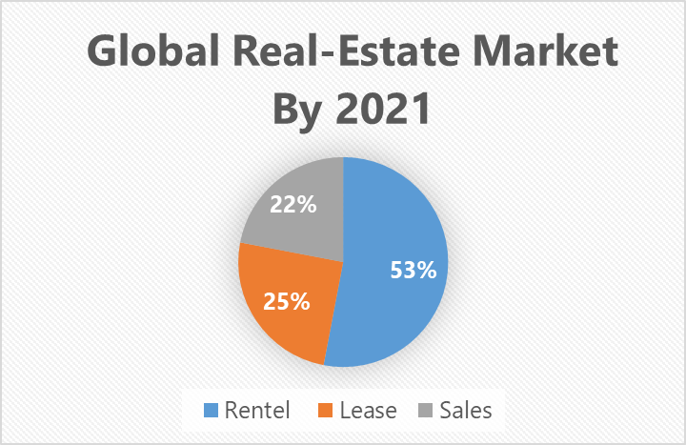
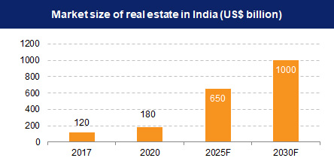
In the real estate realm, transparency, fraud prevention, and complex processes inhibit seamless transactions
Block-Estate
Limited Real Estate Accessibility
Fragmented Ownership Record
Complex Procedure
Problem
Fraud Risk
Inefficiency in Real Estate Transaction
Transparency
Indian Market Size (2023):- USD 265.18 Billion
Present relevant statistics and data that emphasize the significance of the issue.:-
1.Trust and transparency are compromised (75% industry executives; Deloitte).
2.Fraud amounts to substantial losses ($221 million in 2019; FBI).
3.Cumbersome processes involve numerous intermediaries (15-20 per transaction; McKinsey).

Slide 2
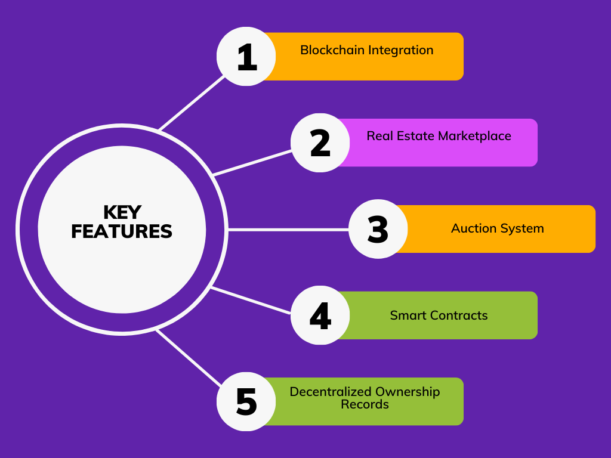
Our Innovative Solution
Our innovative approach integrates blockchain technology into a real estate marketplace with an auction system.
This unique solution tackles challenges by enhancing accessibility, ensuring transparency, expanding auction participation, securing transactions, streamlining efficiency, simplifying ownership records, and boosting auction credibility.
Through this approach, we aim to revolutionize the real estate industry, making it more inclusive, trustworthy, and efficient for all.
Unique Selling points :
Step 1
Step 2
Step 3
Connect The wallet
Search The Property
Buy the property
Bank Auction System
Reducing Corruption
Fast Transaction
1
2
3

